Slide 1
Design and Analysis of Algorithms (UE20CS251)
Unit I - Analysis Framework
Mr. Channa Bankapur
channabankapur@pes.edu

Slide 2
What does it return?
foo(n)
ctr ← 0
for i ← 1 to n
ctr ← ctr + 1
return ctr
Return value: …

Slide 3
What does it return?
foo(n)
ctr ← 0
for i ← 1 to n
ctr ← ctr + 1
return ctr
Return value: n
Algorithm SeqSearch(A[0..n-1], key)
for i ← 0 to n-1
if (A[i] = key)
return i
return -1
How many times “A[i] = key” comparison is made?
foo() exhibits the structure of SeqSearch(). Return value of foo(), the number of times the operation “ctr+1” in foo() executes and the number of times the operation “A[i] = key” in SeqSearch() executes are all the same. This count plays a key role in the running time analysis of the algorithm.

Slide 4
What does it return?
foo(n)
ctr ← 0
for i ← 1 to n-1
for j ← 1 to n-1
ctr ← ctr + 1
return ctr
Return value: …

Slide 5
BSort(A[0..n-1])
for k ← 0 to n-2
for i ← 0 to n-2
if(a[i] > a[i+1])
Swap(a[i],a[i+1])
How many times “A[i] > A[i+1]” comparison is made?
What does it return?
foo(n)
ctr ← 0
for i ← 1 to n-1
for j ← 1 to n-1
ctr ← ctr + 1
return ctr
Return value: (n-1)²
(the product rule)

Slide 6
What does it return?
foo(n, m)
ctr ← 0
for i ← 1 to n
for j ← 1 to m
ctr ← ctr + 1
return ctr
Return value: …

Slide 7
What does it return?
foo(n, m)
ctr ← 0
for i ← 1 to n
for j ← 1 to m
ctr ← ctr + 1
return ctr
Return value: nm
(The number of character comparisons in the worst-case in the Naive String Matching algorithm is same as that of the “ctr+1” operation here)

Slide 8
What does it return?
foo(n₁, n₂, …, n_{m})
k ← 0
for i₁ ← 1 to n₁
for i₂ ← 1 to n₂
.
.
for i_{m} ← 1 to n_{m}
k ← k + 1
return k
Return value: …

Slide 9
What does it return?
foo(n₁, n₂, …, n_{m})
k ← 0
for i₁ ← 1 to n₁
for i₂ ← 1 to n₂
.
.
for i_{m} ← 1 to n_{m}
k ← k + 1
return k
Return value: n₁ * n₂ * ... * n_{m}
(the generalized product rule)

Slide 10
What does it return?
foo(n)
ctr ← 0
for i ← 1 to n-1
for j ← i+1 to n
ctr ← ctr + 1
return ctr
Return value: …

Slide 11
What does it return?
foo(n)
ctr ← 0
for i ← 1 to n - 1
for j ← i + 1 to n
ctr ← ctr + 1
return ctr
ctr: (n-1) + (n-2) + (n-3) + … + 1 = n * (n-1) / 2.
ctr: n choose 2.
SelectionSort(A[0..n-1])
for i ← 0 to n-2
min ← i
for j ← i+1 to n-1
if(A[j]<A[min])
min ← j
Swap (A[i],A[min])
How many times “A[j] > A[min]” comparison is made?

Slide 12
What does it return?
foo(n)
if(n=1) return 1
k ← foo(n-1)
k ← k+1
k ← k + foo(n-1)
return k
Return value: …

Slide 13
What does it return?
foo(n)
if(n=1) return 1
k ← foo(n-1)
k ← k+1
k ← k + foo(n-1)
return k
C(n) = 1 + 2 C(n-1), C(0)=0
= 1 + 2(1+2C(n-2))
= 1+2+2²C(n-2)
= 2⁰+2¹+2²+2³C(n-3)
= 2⁰+...+2^{i-1}+2^{i}C(n-i)
n-i = 0 ⇒ i = n
C(n) = 2⁰+...+2^{n-1}+2^{n}C(0)
C(n) = 2^{n} - 1
Hanoi(n, Src, Dest, Aux)
if (n = 0) return
Hanoi(n-1,Src,Aux,Dst)
Move disk#n from S to D
Hanoi(n-1,Aux,Dst,Src)
return
How many times “Move disk” operation is executed?
Count: 2^{n} - 1

Slide 14
What does it return?
foo(n)
k ← 0
i ← n
while (i > 1)
k ← k + 1
i ← ⌊i/2⌋
return k
Return value: …
foo(n)
k ← 0
if(n > 1)
k ← foo(⌊n/2⌋)+1
return k

Slide 15
What does it return?
foo(n)
k ← 0
if(n > 1)
k←foo(⌊n/2⌋)+1
return k
C(n) = C(⌊n/2⌋) + 1
, C(1) = 0
C(n) = ⌊log₂n⌋
BSch(A[l..r], k)
if(r-l+1 < 1)
return -1
m = ⌊(l+r) / 2⌋
if(k = A[m])
return m
else if(k < A[m])
return BSch(A[l..m-1],k)
else
return BSch(A[m+1..r],k)
How many times “k = A[m]” comparison is made?

Slide 16
C(n) = C(⌊n/2⌋) + 1, C(1) = 0
= C(⌊n/4⌋) + 1 + 1
= C(⌊n / 2³⌋) + 3
= C(⌊n / 2^{i}⌋) + i
C(⌊n/2^{i}⌋) becomes C(1) when ⌊n/2^{i}⌋ = 1.
⌊n/2^{i}⌋ = 1
1 ≤ n/2^{i} < 2
2^{i} ≤ n < 2^{i+1}
i ≤ log₂n < i+1
i = ⌊log₂n⌋
C(n) = C(1) + ⌊log₂n⌋
C(n) = ⌊log₂n⌋

Slide 17
What does it return?
foo(n)
k ← 0
i ← n
while (i > 1)
j ← 1
while (j ≤ n)
k ← k + 1
j ← j + 1
i ← ⌊i/2⌋
return k
Return value: …

Slide 18
What does it return?
foo(n)
k ← 0
i ← n
while (i > 1)
j ← 1
while (j ≤ n)
k ← k + 1
j ← j + 1
i ← ⌊i/2⌋
return k
Return value: n * log₂n
(Element-to-element comparison in Merge Sort is comparable to “k←k+1” here)

Slide 19
What does it return?
foo(n)
k ← 0
i ← n
while (i > 1)
j ← 1
while (j ≤ i)
k ← k + 1
j ← j + 1
i ← ⌊i/2⌋
return k
Return value: …

Slide 20
What does it return?
foo(n)
k ← 0
i ← n
while (i > 1)
j ← 1
while (j ≤ i)
k ← k + 1
j ← j + 1
i ← ⌊i/2⌋
return k
k = n + n/2 + n/4 + … + 4 + 2
k = 2n - 2
Return value: 2n - 2, when n is a power of 2.

Slide 21
What does it return?
foo(str)
k ← 0
n ← length(str)
for each permutation of str
j ← 1
while (j ≤ n)
k ← k + 1
j ← j + 1
return k
Return value: …

Slide 22
What does it return?
foo(str)
k ← 0
n ← length(str)
for each permn of str
j ← 1
while (j ≤ n)
k ← k + 1
j ← j + 1
return k
Return value: n * n!
Travelling Salesman Problem
mincost ← INFINITY
for each perm of n cities
cost ← 0
for each edge in the H_ckt
cost ← cost + edgeCost
if(cost < mincost)
mincost ← cost
return mincost
How many times “cost + edgeCost” addition is evaluated?

Slide 23
Measuring an Input’s Size:
An algorithm takes same or more time for a larger input of similar kind.
Algorithm’s efficiency is measured as a function of its input size.
Eg:
n: size of the array for SequentialSearch(A[0..n-1], K) and SelectionSort(A[0..n-1]).
(m, n, p): for MatrixMultiplication(A[m,n], B[n,p]) of two matrices of order mxn and nxp.
n (or number of bits used to represent n = ⌊log₂n⌋ + 1): the value of the input number in BinaryDigits(n).

Slide 24
Units for Measuring Running Time:
Count in seconds, minutes, etc. -- Standard unit of time measurement. An algorithm may take different time based on
speed of the computing device
implementation of the algorithm
compiler optimization
Count the number of times each of the algorithm’s operations is executed.
difficult to count each of them
not all of them are similar in running time

Slide 25
Count the number of times each of the algorithm’s operations is executed.
Algorithm SelectionSort(A[0..n-1])
for i ← 0 to n-2
min ← i
for j ← i+1 to n-1
if(A[j] < A[min]) min ← j
Swap A[i] with A[min]
return A

Slide 26
Count the number of times each of the algorithm’s operations is executed.
Algorithm SelectionSort(A[0..n-1])
i ← 0 1
while(i ≤ n-2) 1 + n-1
min ← i n-1
j ← i+1 n-1
while(j ≤ n-1) n-1 + n(n-1)/2
if(A[j] < A[min]) n(n-1)/2
min ← j ≤ n(n-1)/2
j ← j+1 n(n-1)/2
Swap A[i] with A[min] n-1
i ← i+1 n-1

Slide 27
Count the number of times each of the algorithm’s operations is executed.
Algorithm SelectionSort(A[0..n-1])
i ← 0 (1) * c₁
while(i ≤ n-2) (1 + n-1) * c₂
min ← i (n-1) * c₃
j ← i+1 (n-1) * c₄
while(j ≤ n-1) (n-1 + n(n-1)/2) * c₅
if(A[j] < A[min]) (n(n-1)/2) * c₆
min ← j ≤ (n(n-1)/2) * c₇
j ← j+1 (n(n-1)/2)* c₈
Swap A[i] with A[min] (n-1) * c₉
i ← i+1 (n-1) * c₁₀

Slide 28
Count the number of times each of the algorithm’s operations is executed.
Algorithm SelectionSort(A[0..n-1])
i ← 0 (1) * (c₁+c₂)
while(i ≤ n-2)
min ← i (n-1) * (c₂+c₃+c₄+c₅+c₉+c₁₀)
j ← i+1
while(j ≤ n-1)
if(A[j] < A[min]) (n(n-1)/2) * (c₅+c₆+c₈)
min ← j ≤ (n(n-1)/2) * c₇
j ← j+1
Swap A[i] with A[min]
i ← i+1

Slide 29
Count the number of times each of the algorithm’s operations is executed.
Algorithm SelectionSort(A[0..n-1])
i ← 0 (1) * c₁₁
while(i ≤ n-2)
min ← i (n-1) * c₁₂
j ← i+1
while(j ≤ n-1)
if(A[j] < A[min]) (n(n-1)/2) * c₁₃
min ← j ≤ (n(n-1)/2) * c₇
j ← j+1
Swap A[i] with A[min]
i ← i+1

Slide 30
Count the number of times each of the algorithm’s operations is executed.
Algorithm SelectionSort(A[0..n-1])
i ← 0 ≤ (n(n-1)/2) * c₁₁
while(i ≤ n-2)
min ← i ≤ (n(n-1)/2) * c₁₂
j ← i+1
while(j ≤ n-1)
if(A[j] < A[min]) = (n(n-1)/2) * c₁₃
min ← j ≤ (n(n-1)/2) * c₇
j ← j+1
Swap A[i] with A[min]
i ← i+1
T(n) ≤ (n(n-1)/2) * c₁₄ , where one basic operation like
A[j] < A[min] executes for (n(n-1)/2) times.

Slide 31
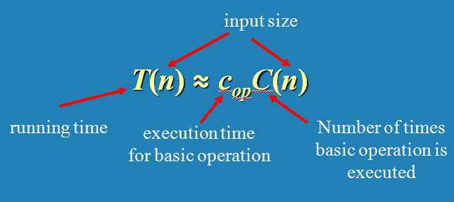
Basic Operation: The fundamental operation of the algorithm, which is contributing the most to the total running time.
Time efficiency: Counting the number of times the algorithm’s basic operation is executed on inputs of size n.

Slide 32
T(n) ≅ c_{op} * C(n)
How much longer will the Selection Sort algorithm run if the input size is doubled or increased 10-fold?
For Selection Sorting algorithm,
C(n) = (n(n-1)/2)
= (n² /2 - n/2)
≅ n²/2 for sufficiently large value of n.

Slide 33

C(n) ≅ n²/2 for sufficiently larger value of n.
For n=1,000 → T(n) ≅ 2 milliseconds
For n=10,000 → T(n) ≅ 200 ms = 0.2 seconds
For n=100k → T(n) ≅ 20000 ms = 20 seconds
For n=1mil → T(n) ≅ 2000 sec ≅ 33 minutes

Slide 34
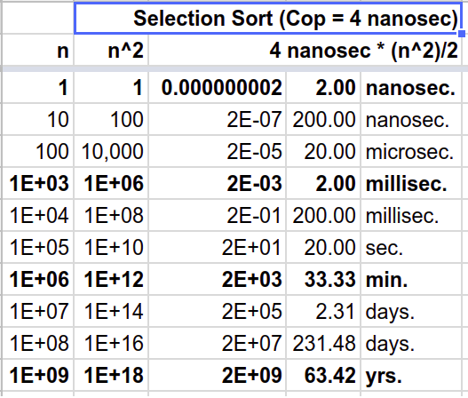

Slide 35
Analysis Framework ignores multiplicative constants and concentrates on the basic operation count’s order of growth to within a constant multiple for large-size inputs. So, the order of growth of selection sort is primarily driven by “n²”.
In the same way, let the order of growth of Mergesort is driven by “n log n”. Suppose, the cost of the basic operation of the selection sort is 4 nanoseconds and that of the mergesort is 40 nanoseconds. What could be the estimated execution time of mergesort on an input size of:
(i) 1 million?
(ii) 1 billion?

Slide 36
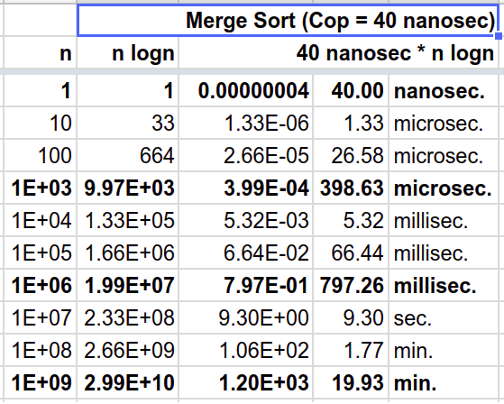

Slide 37
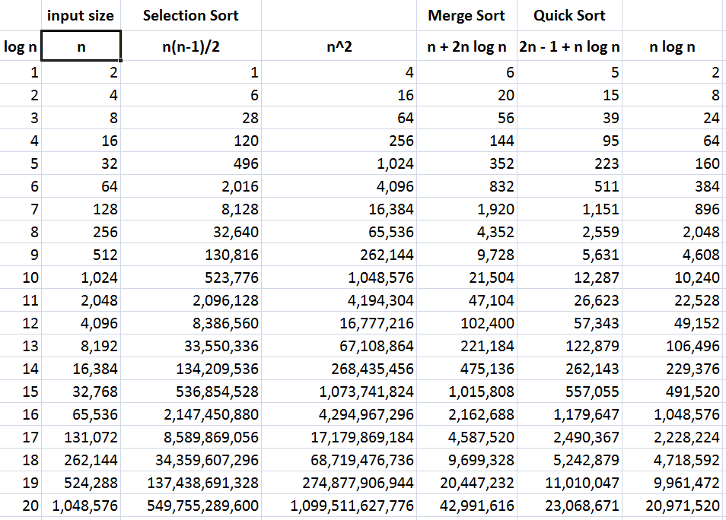

Slide 38
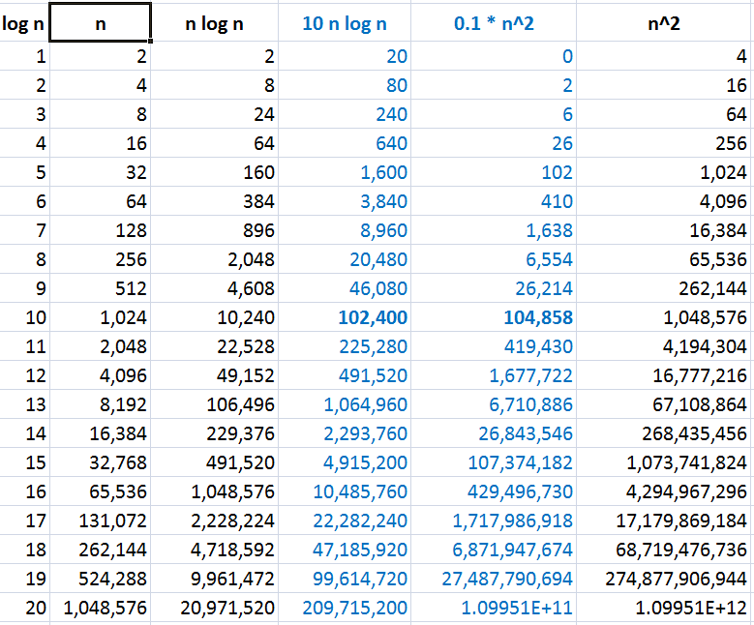

Slide 39
What if the basic operation runs for 2¹⁰⁰ times?
Suppose,
An algorithm takes 2¹⁰⁰ operations.
Tower of Hanoi takes about 2¹⁰⁰ operations for 100 disks.
Each operation takes just one clock tick.
1 terahertz processor exists. (10¹² ≅ 2⁴⁰)
So, the algorithm takes 2¹⁰⁰ / 2⁴⁰ = 2⁶⁰ seconds.
≅ 2³⁵ years (∵ 1 year = 60*60*24*365 ≅ 2²⁵ seconds)
≅ 32 * 10⁹ years (∵ 10⁹ ≅ 2³⁰)
= 32 billion years
BTW, it’s estimated that the Earth was formed about 4.5 billion years back and the big bang happened about 14 billion yrs back!
Algorithms that require an exponential number of operations are practical for solving only problems with very small input sizes.

Slide 40
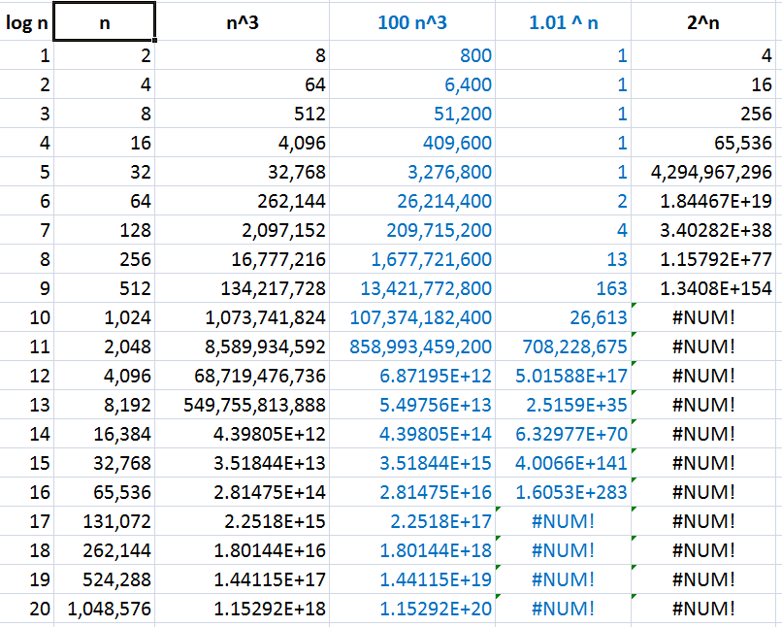

Slide 41
A Problem can be:
Undecidable
No solution exists theoretically
Decidable and Intractable
Solution exists, but …
exponential time (aka super-polynomial time)
Decidable and Tractable
polynomial time solution exists
Reference:
Theory of Computation
NP-Completeness

Slide 42
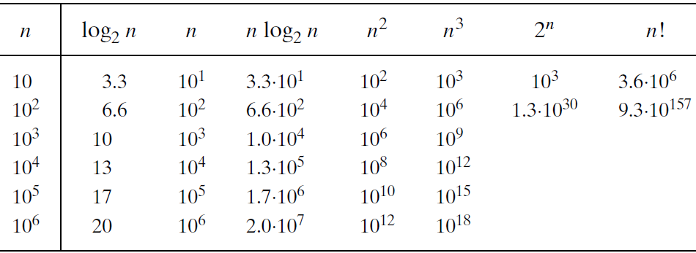
Orders of growth:

Slide 43
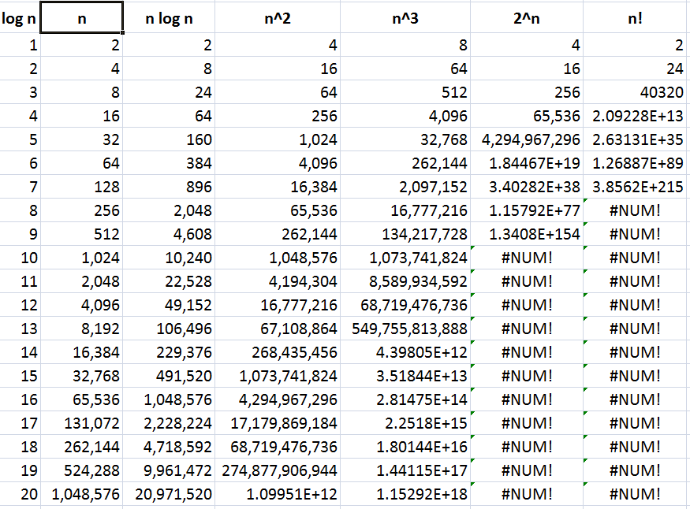

Slide 44
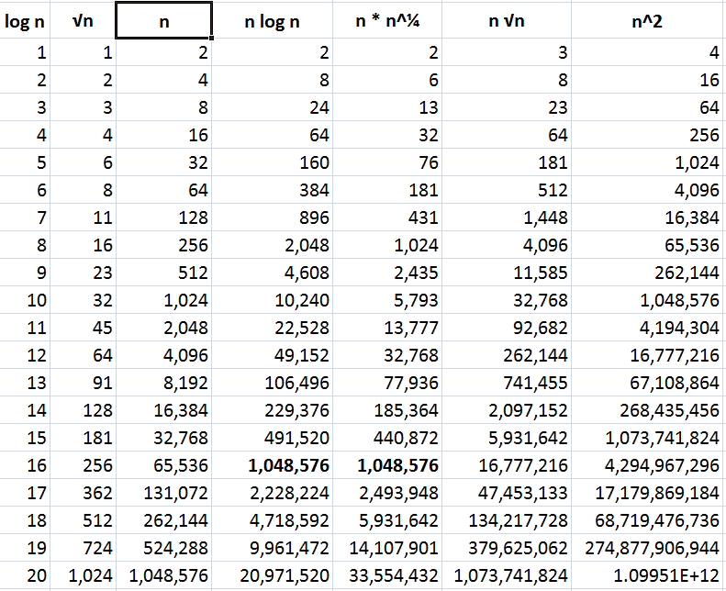

Slide 45
There are many algorithms for which running time depends not only on an input size but also on the specifics of a particular input.
Algorithm SequentialSearch(A[0..n-1], K)
//Outputs the index of the first element of A that
// matches K or -1 if there are no matching elements.
i ← 0
while (i < n) and (A[i] ≠ K) do
i ← i + 1
if (i < n) return i
return -1

Slide 46
Algorithm SequentialSearch(A[0..n-1], K)
//Outputs the index of the first element of A that
// matches K or -1 if there are no matching elements.
i ← 0
while (i < n) and (A[i] ≠ K) do
i ← i + 1
if (i < n) return i
return -1
Input size: n.
Basic Operation: (i < n) and (A[i] ≠ K)
C_{worst}(n) = n+1
C_{best}(n) = 1
C_{avg}(n) = ?

Slide 47
Worst case: C_{worst}(n) – maximum over inputs of size n
Best case: C_{best}(n) – minimum over inputs of size n
Average case: C_{avg}(n) – “average” over inputs of size n
Number of times the basic operation will be executed on typical input
NOT the average of worst and best case
Amortized efficiency (out of syllabus)

Slide 48
Algorithm SequentialSearch(A[0..n-1], K)
If the search key is certainly present in the array:
C_{avg, key present}(n) = (1 + 2 + … + n) / n
C_{avg, key present}(n) = (n + 1) / 2
C_{avg, key absent}(n) = (n + 1)
Let ‘p’ be the probability of the search key present in the array.
C_{avg}(n) = p(n + 1) / 2 + (1 - p)(n + 1)
When p = 1, C_{avg}(n) = (n + 1) / 2
When p = 0, C_{avg}(n) = (n + 1)
When p = 0.5, C_{avg}(n) = 0.75 * (n + 1)

Slide 49
Algorithm SequentialSearch(A[0..n-1], K)
Input Size: n
Basic Operation : (i < n) and (A[i] ≠ K)
C_{worst}(n) = Count of the basic operation at the max
= n + 1
C_{best}(n) = 1
C_{avg}(n) = from (n+1)/2 to (n+1) depending on the probability of search key being present in the input array.

Slide 50
Time efficiency analysis framework concentrates on the order of growth of the basic operation count of an algorithm as the principal indicator of the algorithm’s efficiency.
Asymptotic Notations:
“Big Oh” O(g(n)):
class of functions t(n) that grow no faster than g(n)
“Big Omega” Ω(g(n)):
class of functions t(n) that grow at least as fast as g(n)
“Big Theta” Θ(g(n)):
class of functions t(n) that grow at the same rate as g(n)

Slide 51
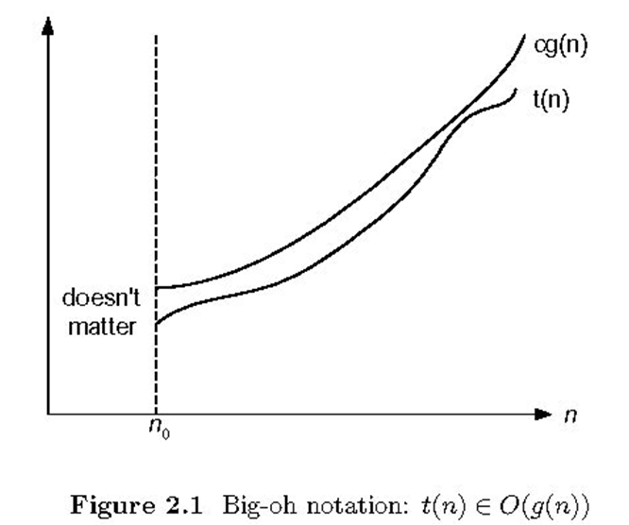
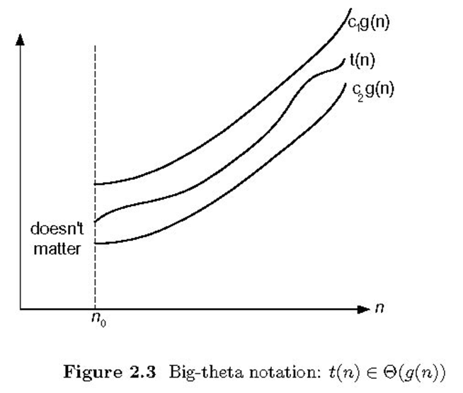
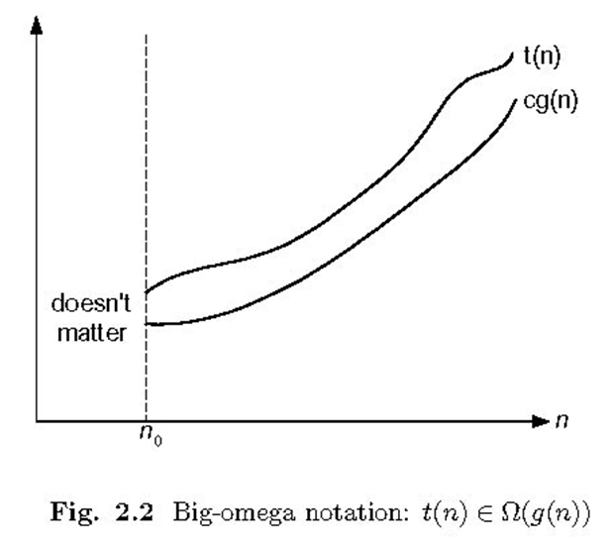

Slide 52
“Big Oh” O(g(n)):
A function t(n) is said to be in
O(g(n)) if t(n) is bounded above
by some constant multiple of
g(n) for all large n.
t(n) ≤ cg(n) ∀ n ≥ n₀
Denoted as t(n) ∈ O(g(n))
Eg: 100n+5 ∈ O(n)
100n+5 ≤ 100n+5n (∀ n≥1)
100n+5 ≤ 105n ∀ n≥1 (∴ c=105, n₀=1)
100n+5 ≤ 100n+n (∀ n≥5) = 101n ∀ n≥5 (∴ c=101,n₀=5)
Eg: 100n+5 ∈ O(n²)
Eg: n(n-1)/2 ∈ O(n²)

Slide 53
“Big Omega” Ω(g(n)):
A function t(n) is said to be in
Ω(g(n)) if t(n) is bounded below
by some constant multiple of g(n)
for all large n.
t(n) ≥ cg(n) ∀ n ≥ n₀
Denoted by t(n) ∈ Ω(g(n))
Eg: 100n+5 ∈ Ω(n)
100n+5 ≥ 100n (∀ n≥0)
100n+5 ≥ 100n ∀ n≥0 (∴ c=100, n₀=0)
Eg: n(n-1)/2 ∈ Ω(n²)
Eg: n(n-1)/2 ∈ Ω(n)

Slide 54
“Big Theta” Θ(g(n)):
A function t(n) is said to be
in Θ(g(n)) if t(n) is bounded
both above and below by
some constant multiples of
g(n) for all large n.
c₂g(n)≤ t(n) ≤ c₁g(n) ∀ n ≥ n₀
Denoted by t(n) ∈ Θ(g(n))
Eg: n(n-1)/2 ∈ Θ(n²)
n(n-1)/2 = n²/2 - n/2 ≤ n²/2 ∀ n≥0
n(n-1)/2 = n²/2 - n/2 ≥ n²/2 - n²/4 = n²/4 ∀ n≥2
n²/4 ≤ n(n-1)/2 ≤ n²/2 ∀ n≥2 (∴ c₁=1/2, c₂=1/4, n₀=2)

Slide 55
t(n) ∈ O(g(n))
Nonnegative functions defined on the set of natural numbers
t(n): algorithm’s running time by counting basic operation
g(n): simple function to compare the count with.
O(g(n)) is the set of all functions with a smaller or same order of growth as g(n).
E.g.: 100n + 5 ∈ O(n)
∈ O(n²)
∉ O(log n)
n(n-1)/2 ∈ O(n²)
∈ O(n¹⁰)
∉ O(n)

Slide 56
Ω(g(n)) is the set of all functions with a larger or same order of growth as g(n).
E.g.: 100n + 5 ∈ Ω(n)
∉ Ω(n²)
∈ Ω(log n)
n(n-1)/2 ∈ Ω(n²)
∉ Ω(n¹⁰)
∈ Ω(n)
Θ(g(n)) is the set of all functions that have the same order of growth as g(n).
E.g.: n(n-1)/2 ∈ Θ(n²)
∉ Θ(n³)
∉ Θ(n logn)

Slide 57
t(n) ∈ O(t(n))
t(n) ∈ O(g(n)) iff g(n) ∈ Ω(t(n))
t(n) ∈ Θ(g(n)) iff g(n) ∈ Θ(t(n))
If t (n) ∈ O(g (n)) and g(n) ∈ O(h(n)) , then t(n) ∈ O(h(n))
If t₁(n) ∈ O(g₁(n)) and t₂(n) ∈ O(g₂(n)) , then
t₁(n) + t₂(n) ∈ O(max{g₁(n), g₂(n)})

Slide 58
Theorem: If t₁(n) ∈ O(g₁(n)) and t₂(n) ∈ O(g₂(n)) , then
t₁(n) + t₂(n) ∈ O(max{g₁(n), g₂(n)})
That is, if
t₁(n) ≤ c₁g₁(n) ∀ n≥n₁ and t₂(n) ≤ c₂g₂(n) ∀ n≥n₂
then
t₁(n) + t₂(n) ≤ c max{g₁(n), g₂(n)} ∀ n ≥ n₀
Proof:
Hint:
W.k.t. for real numbers a₁,b₁,a₂,b₂
if a₁≤b₁ and a₂≤b₂, then a₁+a₂≤ 2 max{b₁,b₂}

Slide 59
Theorem: If t₁(n) ∈ O(g₁(n)) and t₂(n) ∈ O(g₂(n)) , then
t₁(n) + t₂(n) ∈ O(max{g₁(n), g₂(n)})
Proof:
t₁(n) ≤ c₁g₁(n) ∀ n≥n₁
t₂(n) ≤ c₂g₂(n) ∀ n≥n₂
t₁(n) + t₂(n) ≤ c₁g₁(n) + c₂g₂(n) ∀ n ≥ max{n₁,n₂}
≤ c₃g₁(n) + c₃g₂(n) where c₃= max{c₁,c₂}
≤ c₃ (g₁(n) + g₂(n))
≤ c₃ 2 max{g₁(n), g₂(n)}
Therefore, t₁(n) + t₂(n) ∈ O(max{g₁(n), g₂(n)})
where c = 2 max{c₁,c₂} and n₀ = max{n₁,n₂}

Slide 60
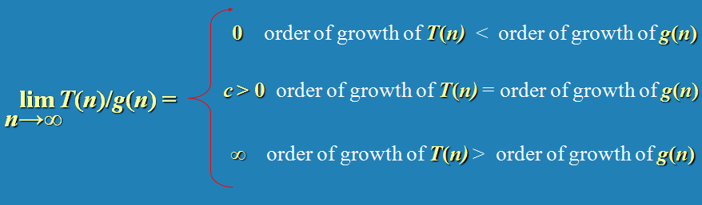
Limits are useful for comparing orders of growth of two specific functions.
Limit of the ratio of two functions reveals the relative orders of growth of the two functions.
How can we relate these three cases to
T(n) ∈ O(g(n)), T(n) ∈ Ω(g(n)) and T(n) ∈ Θ(g(n)) ?
T(n) ∈ o(g(n)), T(n) ∈ 𝛚(g(n)) ?

Slide 61


E.g.: Compare the orders of growth of n(n-1)/2 and n²

Slide 62
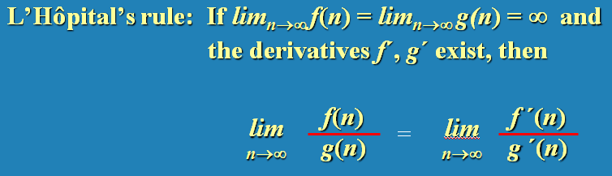


E.g.: Compare the orders of growth of log₂ n and √(n)
Little-oh notation

Slide 63

E.g.: Compare the orders of growth of n! and 2^{n}.

Slide 64
All logarithmic functions log_{a} n belong to the same class Θ(log n) no matter what base of the logarithm a > 1 is.
log₁₀ n ∈ Θ(log₂ n)
All polynomials of the same degree k belong to the same class: a_{k}n^{k} + a_{k-1}n^{k-1} + … + a₀ ∈ Θ(n^{k})
Exponential functions a^{n} have different orders of growth for different a’s.
3^{n} ∉ Θ(2^{n})

Slide 65
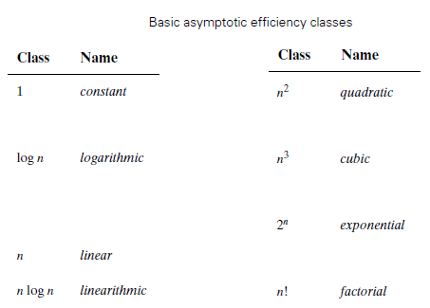

Slide 66
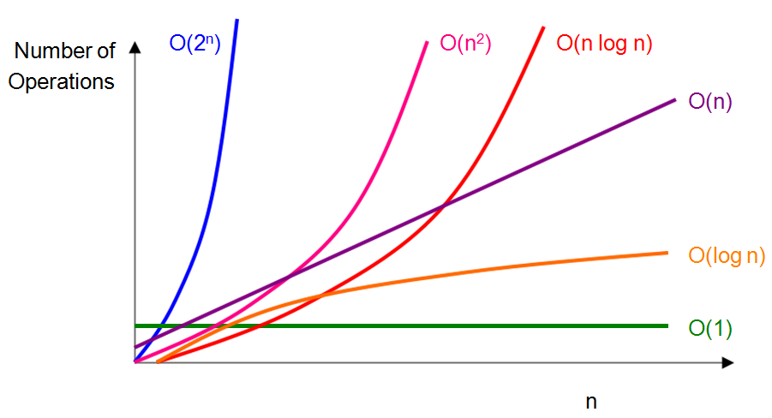
1 < log log n < log n < n^{0.001} < n^{0.5} <
n < n log n < n² < n³ < n¹⁰⁰ <
1.01^{n} < 2^{n} < 100^{n} < n! < n^{n} < …

Slide 67
Analysing time efficiency of recursive/non-recursive algorithms:
input size?
basic operation?
C_{best}(n), C_{worst}(n) and C_{avg}(n), or just C(n)?
Closed-form formula for C(n)
If C(n) is a recurrence, solve the recurrence (or, at the very least, establish its solution’s order of growth) by backward substitutions or some other method.
T(n) ∈ O(), Ω(), Θ()?

Slide 68
Algorithm SequentialSearch(A[0..n-1], K)
//Outputs the index of the first element of A that
// matches K or -1 if there are no matching elements.
i ← 0
while (i < n) and (A[i] ≠ K) do
i ← i + 1
if (i < n) return i
return -1
Input size: n.
Basic Operation: (i < n) and (A[i] ≠ K)
C_{worst}(n) = n+1 ∈ Θ(n)
C_{best}(n) = 1 ∈ Θ(1)
C_{avg}(n) = from (n+1)/2 to (n+1) ∈ Θ(n)

Slide 69
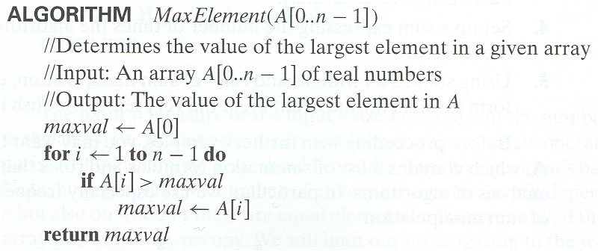
Input Size: n
Basic Operation : ( A[i] > maxval )
C_{worst}(n) = C_{best}(n) = n-1 ∈ Θ(n)

Slide 70
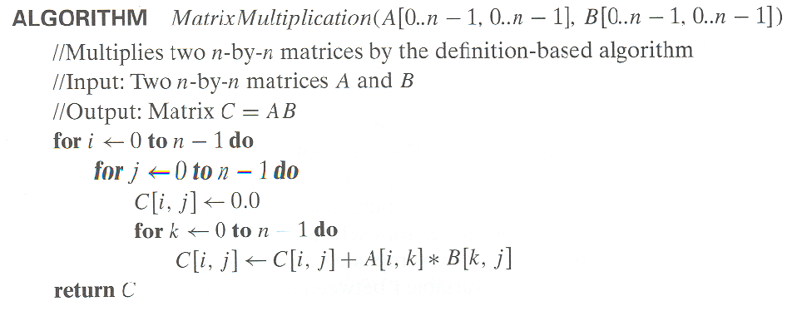
Input Size: n
Basic Operation : Multiplication (A[i,k]*B[k,j])
C_{worst}(n) = C_{best}(n) = n³ ∈ Θ(n³)

Slide 71
Array with distinct elements:
For every distinct pair of elements (A_{i} , A_{j}), A_{i} != A_{j}.
Algorithm UniqueElements(A[0..n-1])
//Determines whether all the elements in a given are distinct.
//Input: An array A[0..n-1]
//Output: Returns “true” if all the elements in A are distinct
// and “false” otherwise.
for i ← 0 n-2 do
for j ← i+1 to n-1
if(A[i] = A[j]) return false
return true

Slide 72
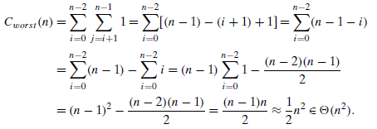
Algorithm: UniqueElements(A[0..n-1])
Input Size: n
Basic Operation : (A[i] = A[j])
C_{worst}(n) = n * (n - 1) / 2 ∈ Θ(n²)
C_{best}(n) = 1 ∈ Θ(1)

Slide 73
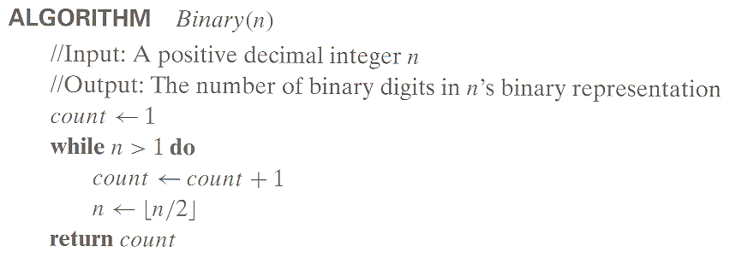
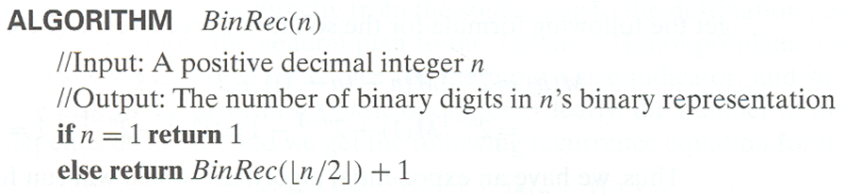
Number of bits needed to represent decimal value n:

Slide 74
Algorithm: BinaryDigits(n)
Input Size: n
Basic Operation : addition
C_{worst}(n) = C_{best}(n)
C(n) = C(n/2) + 1, C(1) = 0
= C(n/4) + 2
= C(n/2³) + 3
= C(n/2^{i}) + i
C(n/2^{i}) is C(1) when n/2^{i} = 1 ⇒ n = 2^{i} ⇒ i = log₂n
C(n) = log₂n ∈ Θ(log n)

Slide 75

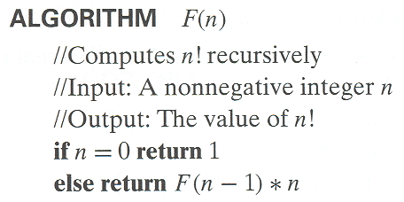
Input Size: n
Basic Operation : multiplication
C(n) = C(n - 1) + 1, C(0) = 0
= n ∈ Θ(n)
Basic Operation : (n = 0) i.e. the number calls to F(n)
C(n) = C(n - 1) + 1, C(0) = 1
= n + 1 ∈ Θ(n)

Slide 76
Algorithm TowerOfHanoi(n, Src, Aux, Dst)
if (n = 0) RETURN
Hanoi(n-1, Src, Dst, Aux)
Move disk n from Src to Dst
Hanoi(n-1, Aux, Src, Dst)
Input Size: n
Basic Operation : Move disk n from Src to Dst
C(n) = 2C(n-1) + 1 for n > 0 and C(0)=0
C(n) = 2 [2 C(n-2) + 1] + 1 = 2² C(n-2) + 2 + 1
= 2² [2 C(n-3) + 1]+2+1 = 2³ C(n-3) + 2²+ 2¹ + 2⁰
= 2³ C(n-3) + 2³ - 1
= 2^{i} C(n-i) + 2^{i} - 1
C(n-i) becomes C(0) when n-i = 0 ⇒ i = n
C(n) = 2^{n} C(n-n) + 2^{n} - 1 = 2^{n} - 1 ∈ Θ(2^{n})

Slide 77
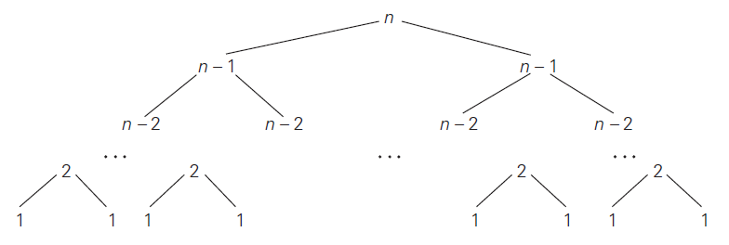


Slide 78
Algorithm TowerOfHanoi(n, Src, Aux, Dst)
if (n = 0) RETURN
Hanoi(n-1, Src, Dst, Aux)
Move disk n from Src to Dst
Hanoi(n-1, Aux, Src, Dst)
Input Size: n
Basic Operation : Move disk n from Src to Dst
C(n) = 2 C(n - 1) + 1, C(0) = 0
= 2^{n} - 1 ∈ Θ(2^{n})
Basic Operation : (n = 0)
C(n) = 2 C(n - 1) + 1, C(0) = 1
= 2^{n} + 2^{n} - 1 ∈ Θ(2^{n})

Slide 79
Algorithm TowerOfHanoi2(n, A, B, C)
if (n = 1)
Move disk n from A to C
RETURN
TowerOfHanoi2(n-1, A, C, B)
Move disk n from A to C
TowerOfHanoi2(n-1, B, A, C)
RETURN
Basic Operation : Move disk n from A to C
C(n) = 2 * C(n - 1) + 1, C(1) = 1
= 2^{n} - 1 ∈ Θ(2^{n})
Basic Operation : (n=1) i.e. the number of function calls
C(n) = 2 * C(n - 1) + 1, C(1) = 1
= 2^{n} - 1 ∈ Θ(2^{n})

Slide 80
Algorithm TowerOfHanoi3(n, A, B, C)
if (n = 0) RETURN
if (n>1) TowerOfHanoi3(n-1, A, C, B)
Move disk n from A to C
if (n>1) TowerOfHanoi3(n-1, B, A, C)
RETURN
Basic Operation : Move disk n from A to C
C(n) = 2 * C(n - 1) + 1, C(1) = 1
= 2^{n} - 1 ∈ Θ(2^{n})
Basic Operation : (n=0) i.e. the number of function calls
C(n) = 2 * C(n - 1) + 1, C(0) = C(1) = 1
= 2^{n} - 1 ∈ Θ(2^{n})

Slide 81

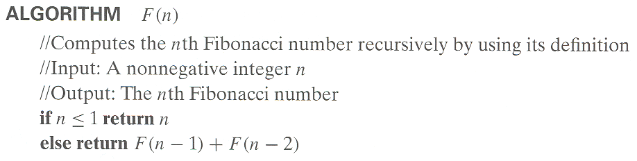
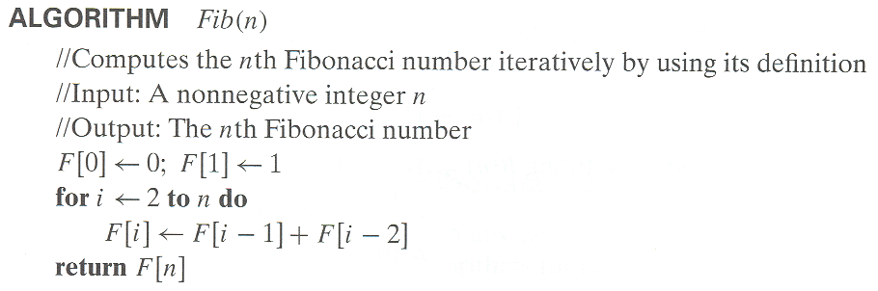

Slide 82
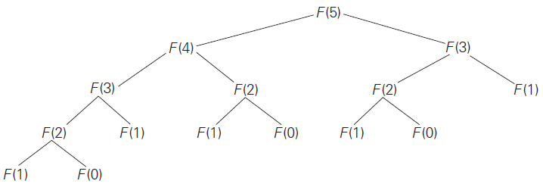

Slide 83
Algorithm: Fib1(n)
Input Size: n
Basic Operation : Addition
C(n) = 1+ C(n - 1) + C(n - 2), C(0) = C(1) = 0
≅ 1.62^{n} ∈ Θ(≅1.62^{n})
Note: On a hypothetical computer with 1 terahertz processor and one clock tick per operation, for n = 100, it takes about 8 years (∵ 1.6¹⁰⁰ ≅ 2⁶⁸ operations ≅ 2³ * 2²⁵ seconds).
Algorithm: Fib2(n)
Input Size: n
Basic Operation : Addition
C(n) = (n - 1) ∈ Θ(n)

Slide 84

Finding nth Fibonacci number:
Algorithm Fib3(n)
//
a = 0, b = 1
for i = 2 to n
c = a + b
a = b
b = c
return b
Algorithm Fib4(n)
//
f = //Closed-form formula
return f

Slide 85
Algorithm Foo(n, k)
sum ← 0
for i ← 1 to n
j ← 1
while(j ≤ n)
sum ← sum + k
j ← j * 2
return sum
Input Size: n, k
Basic Operation : sum ← sum + k
C(n, k) = ? ∈ Θ(?)

Slide 86
Algorithm Foo(n, k)
sum ← 0
for i ← 1 to n
j ← 1
while(j ≤ n)
sum ← sum + k
j ← j * 2
return sum
Input Size: n, k
Basic Operation : sum ← sum + k
C(n, k) = n * floor(1 + logn) ∈ Θ(n logn)

Slide 87
Algorithm Foo(n)
sum ← 0
i ← 1
while(i ≤ n)
for j ← 1 to n
sum ← sum + k
i ← i * 2
return sum
Input Size: n
Basic Operation : sum ← sum + k
C(n) = ? ∈ Θ(?)

Slide 88
Algorithm Foo(n)
sum ← 0
i ← 1
while(i ≤ n)
for j ← 1 to n
sum ← sum + k
i ← i * 2
return sum
Input Size: n
Basic Operation : sum ← sum + k
C(n) = n * floor(1 + logn) ∈ Θ(n logn)

Slide 89
Algorithm Foo(n)
sum ← 0
i ← 1
while(i ≤ n)
for j ← 1 to i
sum ← sum + k
i ← i * 2
return sum
Input Size: n
Basic Operation : sum ← sum + k
C(n) = ? ∈ Θ(?)

Slide 90
Algorithm Foo(n)
sum ← 0
i ← 1
while(i ≤ n)
for j ← 1 to i
sum ← sum + k
i ← i * 2
return sum
Input Size: n
Basic Operation : sum ← sum + k
C(n) = 2n-1 if n is a power of 2
= 2*2^{floor(log n)} - 1 ∈ Θ(n)

Slide 91
Algorithm Foo(n)
sum ← 0
i ← 1
while(i ≤ n)
for j ← 1 to i
for k ← 1 to n in steps of 2
sum ← sum + k
i ← i * 2
return sum
Input Size: n
Basic Operation : sum ← sum + k
C(n) = ? ∈ Θ(?)

Slide 92
Algorithm Foo(n)
sum ← 0
i ← 1
while(i ≤ n)
for j ← 1 to i
for k ← 1 to n in steps of 2
sum ← sum + k
i ← i * 2
return sum
Input Size: n
Basic Operation : sum ← sum + k
C(n) ∈ Θ(n²)

Slide 93
Design. Analyse. Repeat!
</ Analysis Framework >

